Slide 1
INTRODUCTION TO JAVA
Lecture 1 – 1/28/13
CSCI 212
Instructor: Robert Mashburn

Slide 2
Information about this course
Syllabus found on Blackboard
This class will meet for lecture every Monday and Wednesday from 5:30 to 6:20 and for lab every Tuesday and Thursday at the same time.
You are expected to spend time outside of class looking over the programs presented.
You are encouraged to discuss the programs and exchange ideas, and study together for exams.
Work on the extra problems posted on blackboard. Practice is an essential part of doing well in this class.

Slide 3
Java Background
Java is a programming language by Sun Microsystems
“Write Once, Run Anywhere”
Originally based on C and C++
Is often used for programs that run within a web browser(applets), and is sometimes called a “Web Programming Language”
However, in this class, we will be working with Java applications, stand-alone programs that do not require a web browser, similar to other languages

Slide 4
How does Java work?
Source code is written in plain text files ending with a .java extension.
These source files are then compiled into .class files. .class files contain bytecodes, the machine language of the Java Virtual Machine.
A java launcher then runs the application through the Java VM.
Because the Virtual Machine is available on many operating systems, the same .class files can easily be used across Windows, Linux, Mac and other OS.

Slide 5
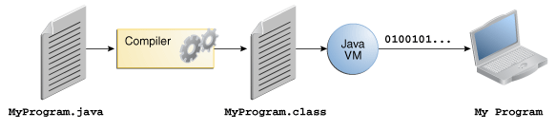
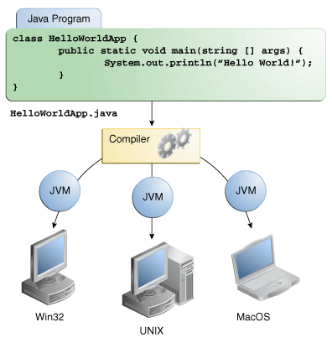
.java files are compiled to .class files that the JVM reads
The JVM is available for most
operating systems, so the same
.java file will run in Windows,
Unix, Mac, and other OS

Slide 6
Java as Programming Language
Java is very similar to C++; however, unlike C++, Java is an object-oriented language.
There are a few basic native types in java
int
double
boolean
Everything else is built from Objects
String
ArrayList
Scanner
Java has built in garbage collection to keep the heap free of unreferenced objects

Slide 7
Getting started with Java
We will be writing all of our Java programs on our lecture and lab computers.
Eclipse will be used for all demonstrations and is the recommended development interface.
http://www.eclipse.org/downloads/
NetBeans is another development interface that you may choose to use.
http://netbeans.org/downloads/

Slide 8
The Basics: Classes and Objects
Class – a template that dictates what objects can and cannot do. Everything in Java is defined as a class.
Object – an instance of a class. An object is, generally speaking, “a thing”.
In Java, a program is written in an object-oriented style that consists of interacting objects.
When we write most code, we must define how an object will act through classes.
Primitive data types are basically the only things that are NOT objects.

Slide 9
Our first program
Our goal: To output a line of text to the terminal
Step 1: Open Eclipse and set up a workspace folder
Step 2: File > New > Java Project; name is CS212
Step 3: File > New > Class
Step 4: In the “Name:” text box, write “HelloWorld”. Note that the name may not contain any spaces.
Step 5: Check the box next to “public static void main”
Step 6: Click Finish

Slide 10
Our first program (cont’d)
We have created our first class.
As we can see on the tab above, this has created a new .java file titled HelloWorld.java.
Each class file we create corresponds to the .java file. The class file MUST be exactly the same as the name of the class.
Attempt to change the name of the class from HelloWorld into HelloWorl. Examine the text and note the error that has formed. Hold the mouse over this error and see how Eclipse detects and can fix this.

Slide 11
Parts of our first class
The first line: public class HelloWorld {
This is the class declaration.
The next line: public static void main (String[] args) {
This is the declaration of the main function or method. Each method may include modifiers and parameters, which will be discussed later, and a return type. In this case, the return type is void because the function does not return anything.
All main functions should look like this.
Note: Comments are used in the same way as in C++.

Slide 12
Hello World Program
Insert the command to print in the main function:
public class HelloWorld
{
public static void main(String[] args)
{
System.out.println("Hello world, how are you?");
}
}
Note: The space between each line, or whitespace, does not affect the code.

Slide 13
Breakdown of code
System.out.println("Hello world, how are you?");
System.out.println(“text”) – This line outputs the message to the terminal (bottommost box in Eclipse).
Two variations; print and println – print simply displays the text, println also outputs a newline to the end of the text. A very useful shortcut.
; - marks the end of the statement.

Slide 14
Reading Input
To take input with Java, we require a certain utility known as the Scanner. This and other utilities will be discussed in a later class.
Scanner lets us read from an input stream, such as the keyboard
Above the name of the class, we must import the scanner utility; this tells the program that we are going to be using a pre-built set of instructions that already exist in Java’s library.
The code is: import java.util.Scanner;

Slide 15
Program for Reading Input
import java.util.Scanner;
public class HelloWorld
{
public static void main(String[] args)
{
Scanner input = new Scanner(System.in);
System.out.print("Enter your name: ");
String name = input.next();
System.out.println("Hello “ + name + ", how are you?");
}
}

Slide 16
Reading Input Breakdown
import java.util.Scanner;
Imports the Scanner utility
Scanner input = new Scanner (System.in);
Declares a new variable named “input” of the object type Scanner. This variable will read the user’s input from the keyboard, as shown by System.in.
System.out.print(“Enter your name:”);
Prompt the user to enter his or her name

Slide 17
Reading Input Breakdown
String name = input.next();
Declares a new variable “name” of the object type String.
input.next() will read from the input device (keyboard) for the next String and assign it to “name”
System.out.println(“Hello ” + name + ", how are you?");
Prints the message to the screen. Words in quotes are displayed exactly as typed, but name is a variable and will show the String assigned to “name”
+ sign acts as a way to concatenate Strings together

Slide 18
Code for Fahrenheit to Celsius
import java.util.Scanner;
public class ConvertFtoC
{
public static void main(String[] args)
{
Scanner input = new Scanner(System.in);
System.out.print("Enter the temperature in Fahrenheit: ");
double fahrenheit;
fahrenheit = input.nextDouble();
double celsius = (fahrenheit - 32) / 9 * 5;
System.out.println("The temperature in Celsius is " + celsius);
}
}

Slide 19
Tonight!
Send me an email at MashburnQC@gmail.com from your preferred email address that you are able to check on a regular basis. The subject line should be: CS212 Spring Session 2013 <first name> <last name>
Make sure that you are able to access Blackboard from your home computer.
Install Eclipse, NetBeans, and/or other Java interfaces that you wish to use at your home computer using the links in the earlier presentation.

Slide 20
Lab Day 1 – Tuesday 1/29/13
Each day in Lab, you are expected to do the following:
Go over the examples discussed in lecture and ensure understanding of the concepts discussed
Attempt to complete the exercises given. These will not usually be graded or required to be submitted, however, you are expected to complete them. Make sure they are available upon request. Solutions will be provided.
Begin working on assignments. Assignments will be given with a specified due date. They must be submitted and will be graded.

Slide 21
Lab Day 1 – Tuesday 1/29/13
On Blackboard, under this class, find the Examples and Exercises tabs, you will find the files that should be looked at.
The Assignment tab has no content yet; your first assignment will be given shortly.
Every PowerPoint presentation will also be found on Blackboard, as well as the recommended reading from the textbook relating to the lecture.

